Slide 1
INPLAN Suite Training Plan
with Bill Sights

Slide 2
High Level Topics of Discussion
INPLANS: who, what, where, when
Basic Definitions: Telephony and Networks
Sub Systems of INPLANS
Physical System Structure, Mainframe locations
General Architecture of Software
Mainframe Facilities
Where JCL and documentation is located
Details outside of INPLAN but necessary for support
ChangeMan and AOTS
MOTS
EDW
Projects for enhancing INPLANS

Slide 3
Detailed Training Topics
INPLANS description
Network Planning & Engineering dept.
Network entities and CLLI Code definitions
INPLANS sub-systems description (PVI and DFG)
CLDS description and usage
INPLANS installation sites and usage
Telcordia software vs. Locally Developed software
Use of QMF for Windows
3270 emulation
PDF
SSO
MOTS
EDW Metadata
PHONE website
DB2 Help email address and usage
CHGMAN
Technical resources available (DB2 help, Changeman_MVS, Sheronda)
RACF security
EPAS role
ESP scheduler
Obsolete INPLANS subsystems
PGG maintenance - queries
QMF for Windows
QMF on the mainframe
INPLANS shared drive
AOTS
CMNTOOLS
IDTF purpose and usage
NDM command
SDSF
Lat/Lng updates (WA314NDM)
HICAP NDM with trigger (WA345NDM)
Enhancement history: DB2 v10
SDC for SE
DFG for South
DFG overview – WFM* and WA3* job series (load, trend, extract or report)
- WAD5 table spaces
PVI overview – WPN job series
- WAD1 table spaces
DFG HICAP forecast (don’t load until finished)
DOS batch for HICAP forecasts
Processing flow: Feeder systems to EDW tables
Extract jobs - WC415A1X (for DBC5 and DA1G) and WC415A1A (for DBC7)
Merge jobs - WC6* series of jobs (to merge 3 DB2 region’s(DBC5, DBC7, and DC1A)data together)
Send files to EDW - WC415NDM to send extracted files to the EDW using NDM
BAE annual updates (first quarter)
Creating a GDG with a command or JCL
FileAid
SCM Inventory
Xpediter

Slide 4
Use of INPLANS in Network Planning and Engineering
Basic Facility Information
Accumulate data for each piece of hardware in the Telephone Network and its location
Used by Engineering to draw maps in EGIS (Expanded Geographic Information System). EGIS accesses tables from EDW and draws the maps
Used to understand what we have today and how to plan for the future
Telephone Network Data Circuits (not Voice)
Accumulate data for HICAP (high capacity) data circuits (e.g., Cell Tower to Data Office, Corporate data circuits, ATMs, etc)
Data Circuits are reliable and most secure form of transmission
Network Planning extracts volume usage information from Data Circuits to predict, forecast future volume

Slide 5
CLLI (common language location identifier)
A unique identifier for a Network entity, a thing that exists in the network (manhole, switch, CO) is identified via CLLI code
CLLI code is either 8 or 11 chars
AAAABBCCDDD
AAAA: [pos 1-4] 4 character code represents geographical area
BB: [pos 5-6] 2 character code represents geopolitical code
CC: [pos 7-8] 2 alphanumeric character code is unique identifier. If both Numeric or both Alpha. Code represents a building.
DDD: [pos 9-11] 3 alphanumeric code represents specific network element i.e., RS type switch
Each CLLI code has an associated longitude/latitude to determine its location in the Facilities Network
Data Circuits are identified by 2 CLLI codes representing the Origin and Destination of the circuit, e.g., Cell Tower to Central Office

Slide 6
WHAT is INPLANS?
INPLANS is a simple but complete ETL (Extract, Transform, Load) process.
It accepts a sequential feed of data from feeder systems + other sources.
INPLAN refines/transforms the data onto the EDW
INPLANS data allows business to do forecasting , e.g., future demand on data circuits
INPLANS Suite
EDW
Feeder Systems
Send RAW data
CLDS (common language data systems)
Collect Data
Co-relate Data
Use Telcordia logic
Transform Data
Data is stored and in its ‘complete’ form
Data can be used by Network and Engineering for forecasting

Slide 7
INPLANS List of Batch Processes
No Online
Weekly Processes
Monthly Processes (generate next month’s forecast)
Semi-Annual (February and August
Hi-Cap
Daily Maintenance Items e.g. consolidation of PDS’s

Slide 8
Sample INPLANS BatchData Processing
Feeders
Feeder System Files
Prod1
INPLANS Prod 1 batch run
CLDS split file
CLDS for Prod1
EDW
CLDS file split batch run
Feeders
Feeder System Files
Prod2
INPLANS Prod2 batch run
CLDS split file
CLDS for Prod2
Feeders
Feeder System Files
Prod2
INPLANS Prod2 batch run
CLDS split file
CLDS for Prod2

Slide 9
Facility Configuration
AA00: environment where Telcordia code is delivered and tested
HA00: environment where INPLANS software build happens (compiles and binds). AA00 environment is linked to capture new Telcordia release code
FC00 (PROD 2): SBC (includes SouthWestern Bell, PacBell/Nevada Bell, New England Bell)
FC00 (PROD 2): MidWest (Ameritech)
EC00 (PROD 1: Everything else (BellSouth, Rest of the World)
2 TEST Facilities
3 Production Facilities

Slide 10
INPLANS MVS Libraries
REGIONS | Natl/Local (STLOUISC) | SBC/8 states (STLPRODC) | AIT (STLPROD2) | TEST (SLTESTP) | DEVL
System | PROD1(SL01) | PROD2(SL02) | PROD2(SL02) | TEST(SLT1) | DEVL
Identifier | EC00 | FC00 | FC00 | HA00 | AA00
Node | N10 | N20 | N20 | N1 | N1
HLQ | INPLNUU | INPLNC | INPLNAP | INPLNA | INPLN@
DB2 Region | DC2A | DBC5 | DBC7 | DBA4 | DA1G
IMS Region |  | IMC5 | IMC5 | IMA5
Libraries
Execution JCL | hlq.JCL
Cataloged Procedures | hlq.PROCLIB
Telcordia Load Library | hlq.LOAD
LOCAL Load Library | hlq.LOCAL.LOAD
Control Cards | hlq.SYSIN
Telcordia DBRM Library | hlq.DBRM
Local DBRM Library | hlq.LOCAL.DBRM (hlq.DBRMLIB on TEST)
Binds | hlq.TEST.JCL (obsolete – use CHGMAN promote)
Application | DB2 System
DFG: | DB**WAD5 | WAD05 | (Not on DBC7 and DC2A)
LOCAL: | DB**WAD3 | WAD03
PVI/ITE: | DB**WAD1 | WAD01
LOC (obsolete, use CLDS) | DB**WAD4 | WAD04 | (WAD06 on TEST)
Notes:
LEGEND:
Regions pertain to the separation of the Bell Companies.
System pertains to the physical mainframe system supporting INPLANS for the region
Identifier is the logical name given to the mainframe system for the different mainframe environments
Node is a secondary id for the mainframe systems
HLQ is a high level qualifier for naming the INPLAN datasets for each environment
DB2 Region is the tablespace name given to the specific DB2 environments of each region
Interesting Fact: The MidWest has a special HLQ because the companies wanted a separation of data during the time of merger. At the time, the belief was that the volume of data from the MidWest was enough to warrant its own partition and processing.

Slide 11
INPLANS Suites Basics
INPLANS
INPLANS has 5 distinct collection of software. Each collection is called a product
5 product names are:
PRF (Middleware)
COMN (Common routines)
DFG (Consists of 2 data areas: Demand Forecast Group and Program Group Guidelines)
ITE (Integrated Traffic Engineering
PVI (Planning View Inventory
Each product has several code libraries stored in PDS and organized by product, source code type and programming language
PRF
PDS source code Libraries
COMN
Product/Source Code Type/Programming Language
DFG
ITE
MAC (macro datasets)
SUB (sub routine datasets)
PGM (program datasets)
MSB (Assembler Utility subroutines)
PVI

Slide 12
DFG (Demand Forecasting group
DFG overview, jobs and QMF queries for DFG, DFG Hi-Cap Forecast

Slide 13
DFG (Demand Forecast Group and Product Group Guidelines)
OVERVIEW:
The DFG database is an integrated database containing unified set of forecast data for a TelCo’s products and services
PURPOSE OF DFG: DFG database contributes to effective business decision making by providing data to support various analyses of individual (or groups of) services, including where the demand will be realized and were demand from individual locations, or groups of locations originates. DFG database also has the flexibility to handle customer demand data for various disciplines and facilities integrating forecasts across various disciplines
The Product Group Guidelines (PGG) Data area contains a TelCo’s service groups. The data area provides flexible structures to define service groups and hierarchies of service groups. The PGG data can be used by DFG database aggregation feature. PGG is used to validate services in DFG. PGG is basically a group of tables specifically used to support DGF
Notes:
With Access Lines dwindling… is there a business case for forecasting usage? Is the data INPLANS is collecting used to forecast demand for other products?

Slide 14
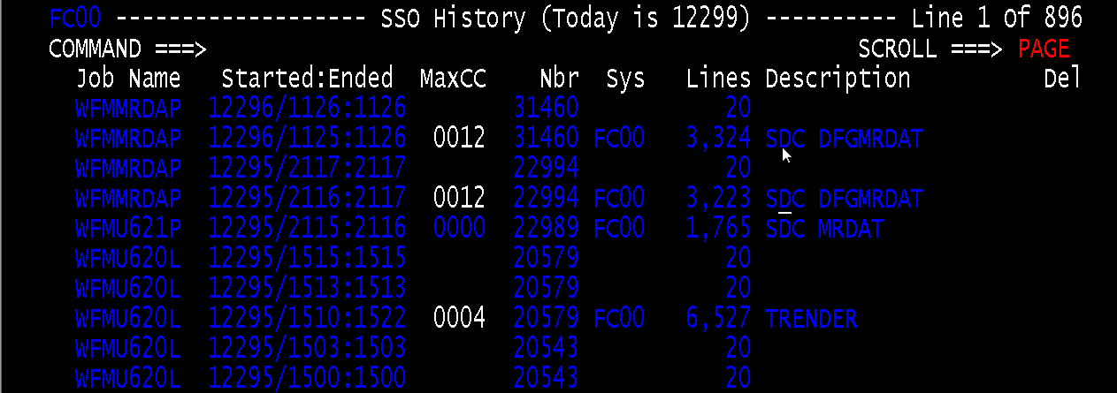
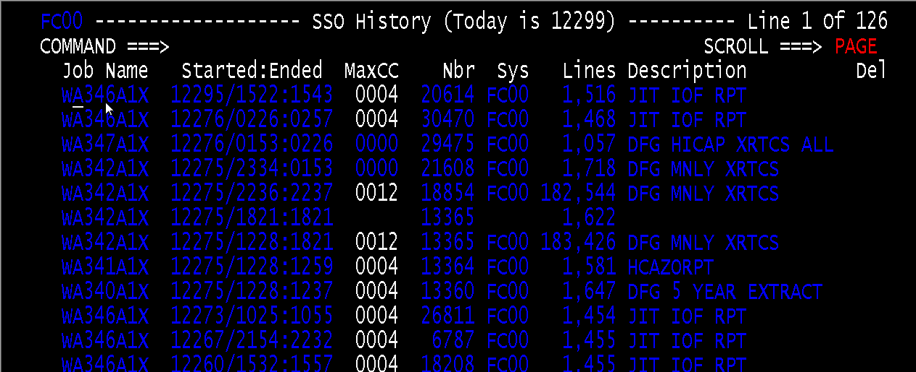
DFG Notes
1. In a nutshell, for a given piece of circuit, if you have a CLLI code and collect monthly usage on that CLLI code over a period of years. You will eventually collect historical usage on that CLLI code. This knowledge allows you to make predictions and make smart decisions based on the trends that develop over time.
Example Scenario: Monthly usage for Telephone Switch increases at a rate of 1% per month for specific period
Hypothetical Forecast: There is gradual increase in usage that will approach Switch capacity within the year. Need to add capacity for that specific location.
2. DFG jobs start with WFM and can be found in SSO. WFM jobs are Telcordia jobs. Description in SSO gives high level description of jobs and source of files (e.g. SDC MRDAT, TIRKS, TRENDER)
2.a: TRENDER jobs are run once a month to update 5 year forecasts
3. WA3* series of jobs are extracting data from DFG and creating reports. These are COBOL programs, you can investigate the WA3 programs to look at the SQL queries used for DFG tables.

Slide 15
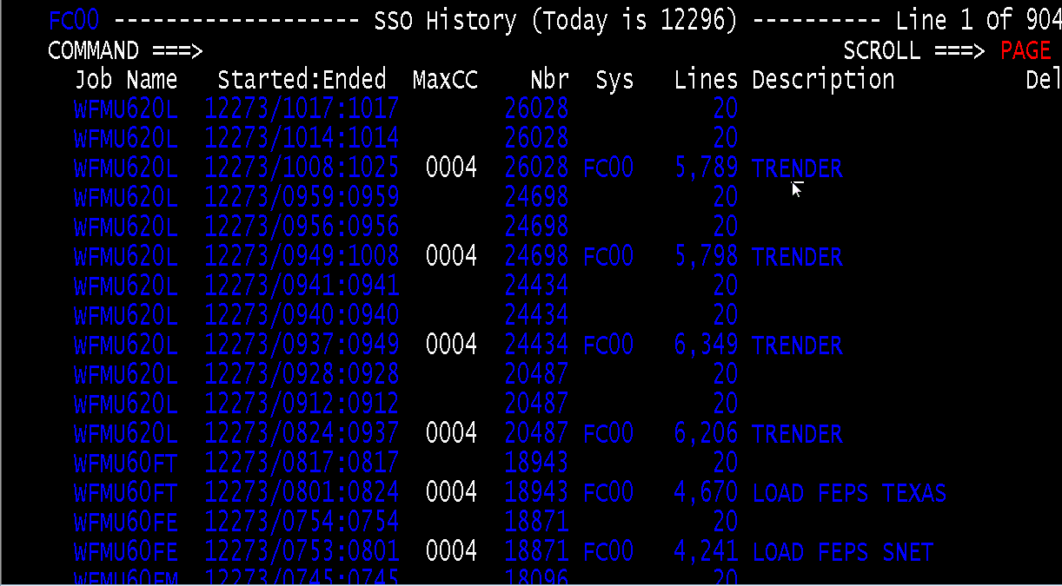
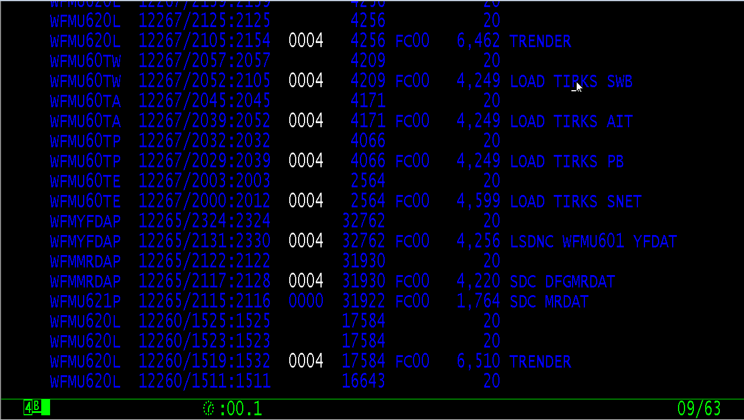
DFG Notes Continued
Data Collection :
INPLANS receives weekly Data File from CLDS
INPLANS also receives monthly files that provide data on volume of circuits. After 12 months of receiving data, we have monthly volumes of circuits and how they vary over time. . See “LOAD xxxx” jobs in SSO. “LOAD FEFS TEXAS” is a job that sends Facility Engineering System monthly volume files from Texas.
NOTE: Feeder systems contain the weekly data. INPLANS has the historical data.
DFG Features:
Forecasting.
Using volume data, the Telcordia programs use forecasting logic. DFG “trender” is the forecasting logic. See the “TRENDER” jobs which are forecasting algorithms that are run for the regions
Reports
See WA3* job example

Slide 16
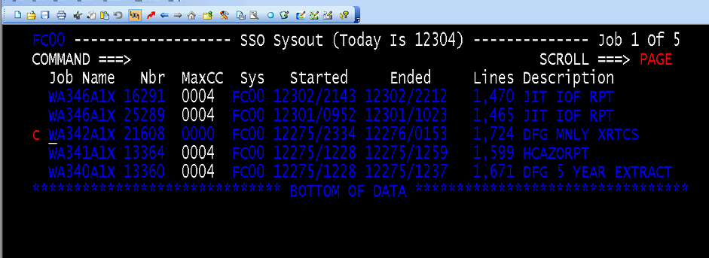
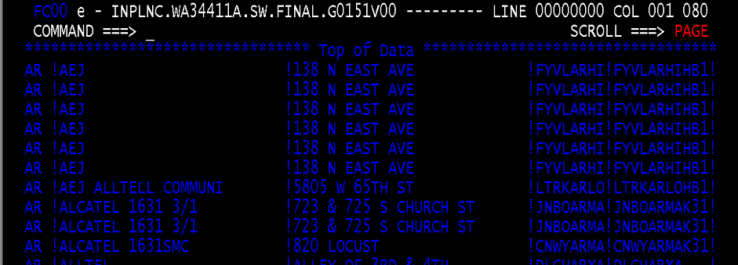
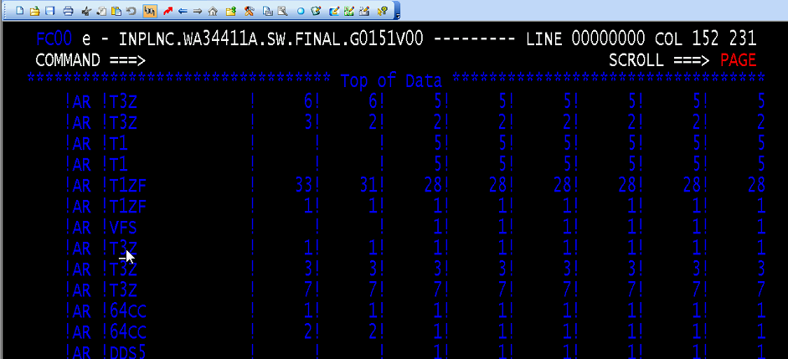
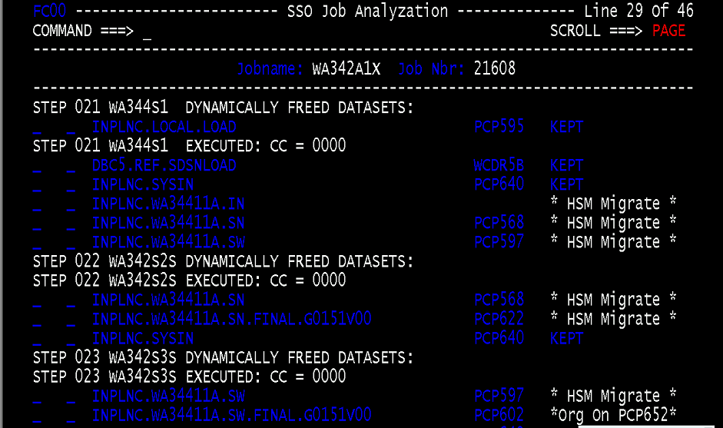
WA3* example
Below are example WA3 job runs sample outputs
SSO
File in browse mode
Files from WA342A1X job
AR is Arkansas. T3Z and T1 are lines.
The numbers are current quantity and last
5 are the 5 year forecast

Slide 17
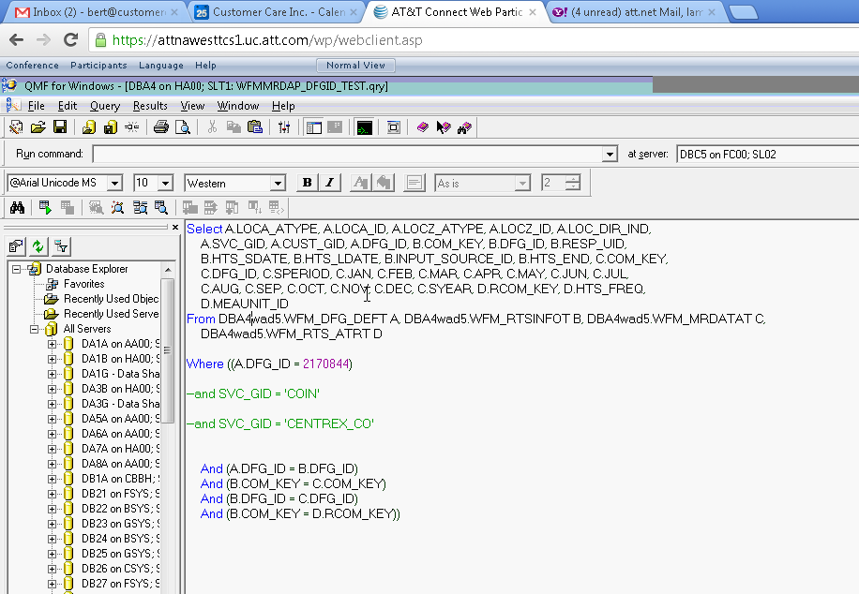
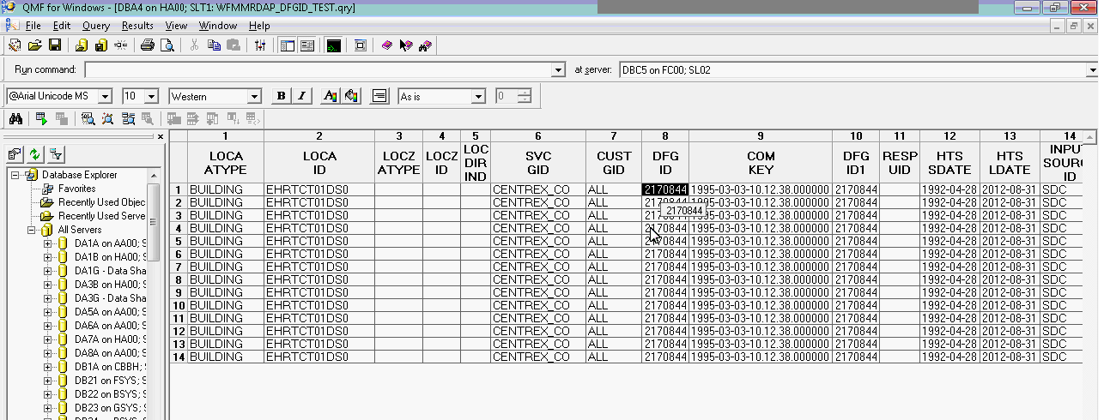
DFG and QMF for Windows
QMF for Windows queries are used to :
Search the DFG database and get DFG data using ‘canned queries’. Queries are found in the shared drive INPLANPICS. Check WA3* jobs as well for queries
Sample query and results shown on right
Notes:
All of DFG tables are in WAD5 tablespace. All of PVI tables are in WAD1 tablespace.
Prod is in DBC5WAD5
Test is in DBC4WAD5
DFG_ID: is unique key for CLLI code combination. DFG_ID is a custom key created by Telcordia programs when data is inserted to the DFG tables.
LOCA_ID: is location id or “CLLI code”
COM_KEY: is Telcordia program generated key.
SVC: is type of Service for that CCLI code
HTS_SDATE: is start date
HTS_LDATE: is last date
INPUT_SOURCE_ID: where data comes from
SPERIOD: start period or period when accumulation began
SYEAR: start year

Slide 18
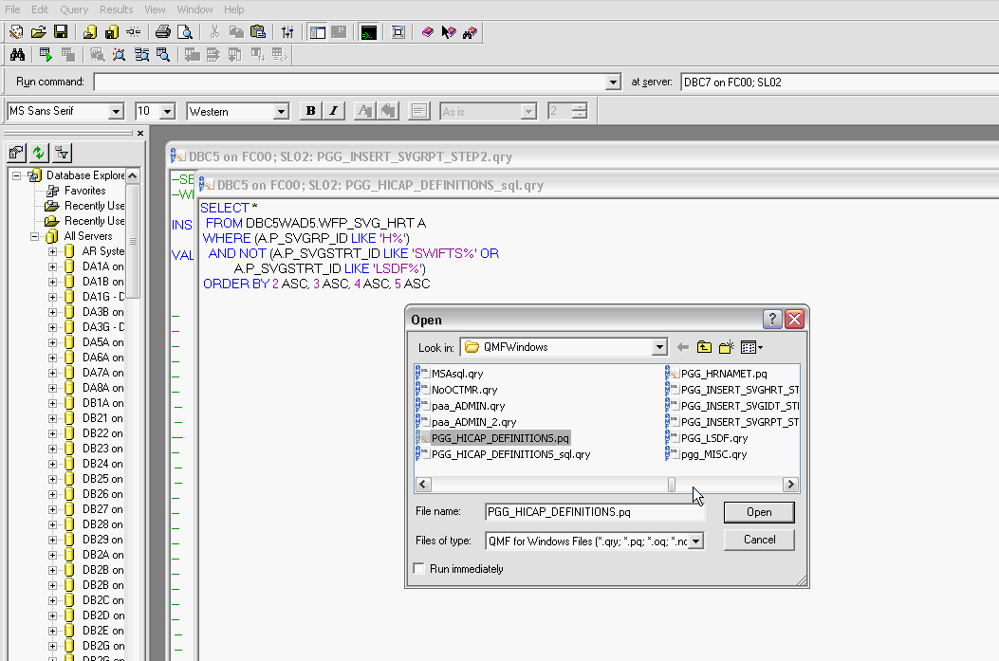
PGG
PGG is now just a collection of reference tables used by DFG for forecasting. Tables contain all services provided by ATT for HICAP.
Once upon a time it was a separate sub-system with an Online IMS user interface used to manage data used by DFG.
In PGG there is a hierarchy of services. Services are grouped in hierarchy of related services in a group. Accumulation of data occurs in that group level.
PGG is maintained by CCI. There are occasions when table updates are requested.

Slide 19
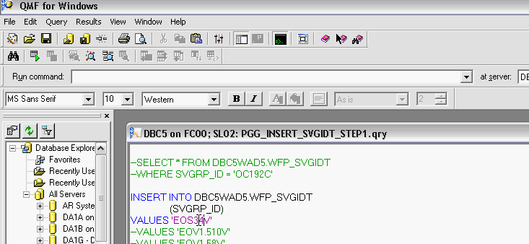
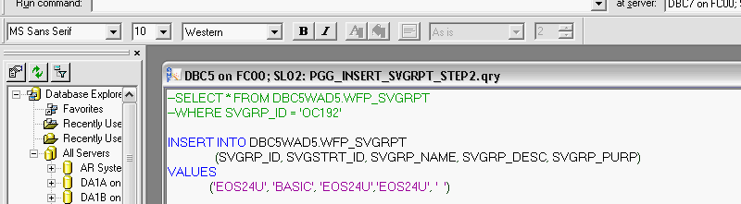
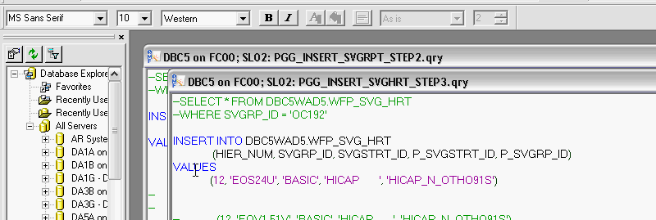
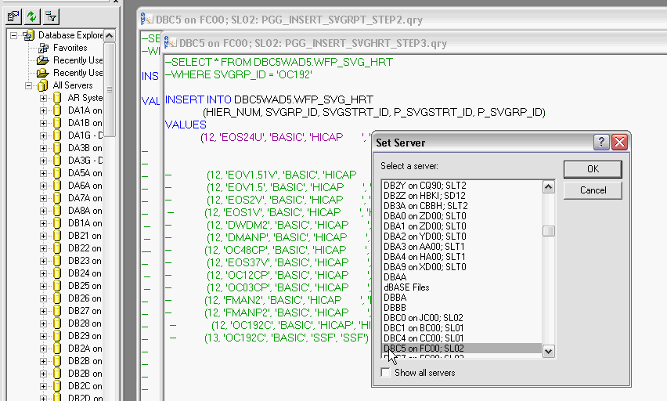
Scenario: Carol Spivey sends email stating a new service needs to be defined in DFG
step1
Task entails updating PGG tables via SQL queries executed from QMF for Windows.
The PGG table updates only happen in DB2 Region DBC5. The SQL update queries are only updated in that region
The 3 specific QMF queries are stored in the INPLANS network shared drive and are run in this order :
PGG_INSERT_SVGID_STEP1.qry
PGG_INSERT_SVGID_STEP2.qry
PGG_INSERT_SVGID_STEP3.qry
Step1: Insert ‘EOS34V in STEP1.qry
Step2: Insert values in STEP2.qry
Step3: Insert values in STEP3.qry
Step4: Set server to “DBC5 on FC00; SL02”
Need RACF to execute SQL update. DFG is only in INPLANC region. (DFG is really used only for West and SW region… DFG can only do one forecast… it cannot be split up.
Tables have 3 nodes DBC5WAD5.WFP_SVG_HRT . CCI gets update access on tables as part of INPLANS support.
step2
step3
step4

Slide 20
DFG HI-CAP FORECAST
Prologue: Creating forecast data using input from the ‘TRENDER’ jobs is a BAU function done by DFG. The forecast is computed by DFG using past history data and is made available every month by the WA3* series jobs
On a bi-annual basis, the BAU process is purposely interrupted to account for ‘current’ Marketing Intelligence data’ such as new construction, damage to facilities, etc. The HI CAP forecast is an On-Demand job that factors current state marketing intelligence data. It updates the forecast based on “current” network data.

Slide 21
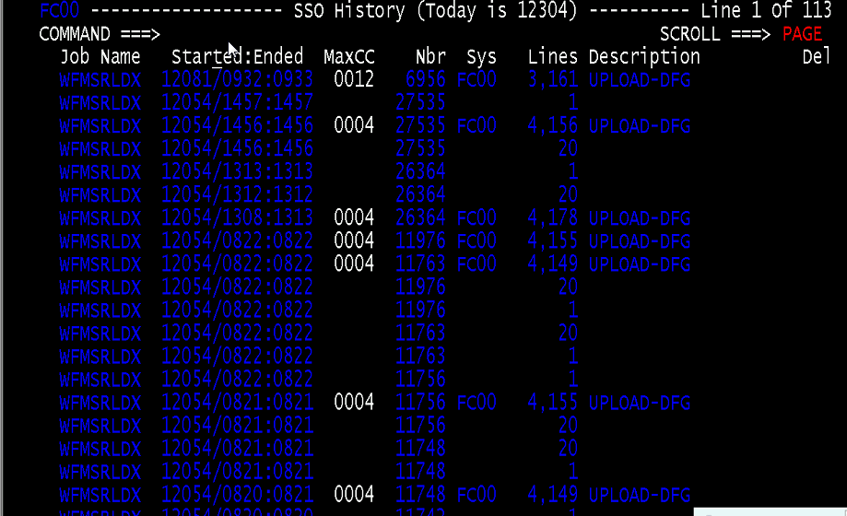
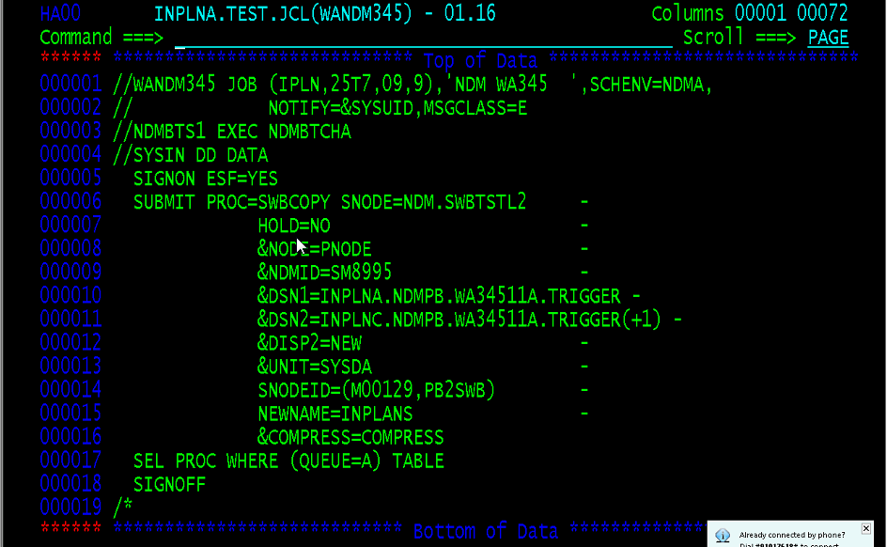
HI-CAP Processing OverviewScenario: Client requests HI-CAP forecast
DFG Upload Jobs
1. DFG jobs are suspended upon announcement of the HI-CAP request (??)
2. Users download the specific WA3* files they need. These files are read into Excel and the forecast values/numbers are manually updated.
3. When update files are ready, Users use a documented process for HICAP (see shared drive HICAP upload programs) to upload their local files to the mainframe. Users are emailed a MS DOS batch file which they run on their local machines that will automate the transmission of their files.
4. Users run DFGUPVAL which validates their updates and DFGUPLOD is run if all records are validated and error free
5. WFMSRLDX job runs automatically(??) which creates 2 forecasts. Current DFG Forecast and the HI-CAP
6. Client Carol Spivey requests CCI to ‘Run the Error Reports’. CCI submits WANDM345 job.
7. If there are errors, cycle repeats (step 2-6) until no errors.
8. DFG job suspension lifted.
Error Reports Job

Slide 22
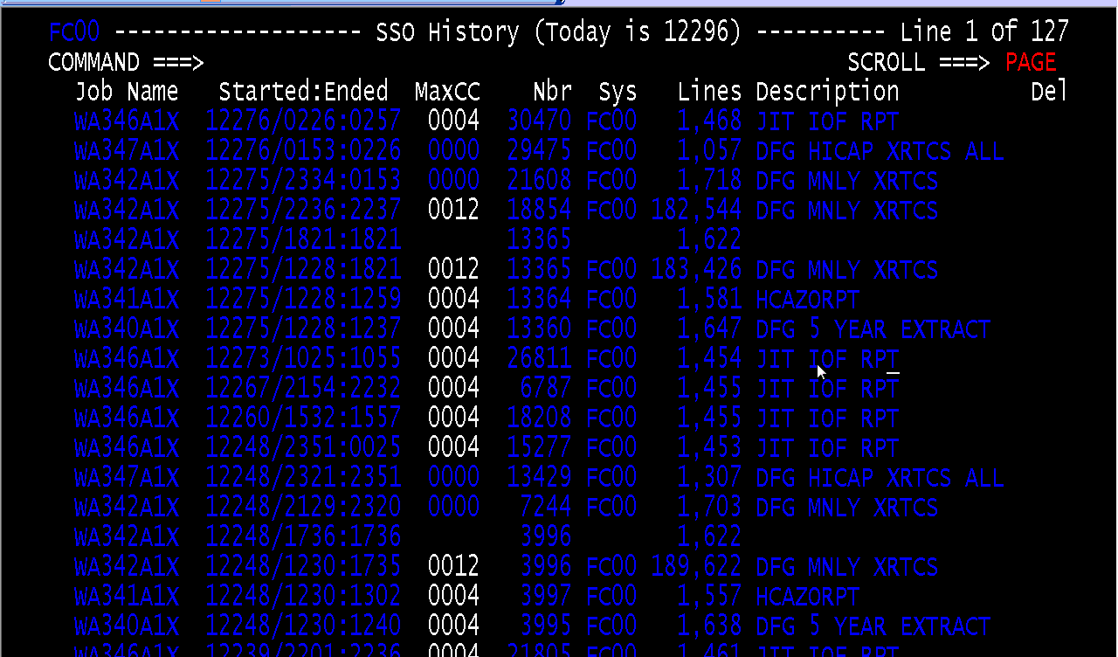
WA340 notes
HICAP
AZ - terminology A to Z. CLLI code origin A to CLLI code end Z

Slide 23
PVI (Planning view of inventory)
PVI overview, PVI jobs

Slide 24
Inventory Overview
PVI consists of anything countable or measurable in the network that is of interest to the Planning function. Most of the data associated with the Planning process involves either counts of total, spare, and assigned quantities of equipment and facilities at various locations in the network, or capacity and usage measurements for traffic network elements. The locations can range from a separate Distribution Area to an entire company. The equipment and facilities to be counted or measured can range from a single piece of cable to a broad classification of items such as all cable and fiber without regard to gauge or type. They can be loop, central office, or interoffice equipment or facilities.
PVI enables you to maintain the appropriate level of inventory data required to support the Planning process in an integrated fashion with minimal redundancy.
The following three categories of Inventory data can be maintained in PVI:
Network Element Items—the individual switches, access lines, trunks, trunk groups, and processors used to provide service
Network Element Groups—groupings of Network Element items that are monitored as a single entity (for example, all trunks terminating on a switch or all access lines belonging to a particular customer)
Aggregated Inventory Items—“aggregations” of detailed Network Element items so that summary counts of total, spare, and assigned quantities can be identified.

Slide 25
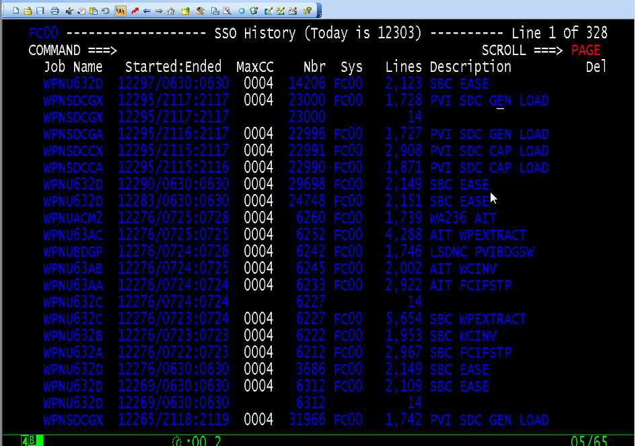
PVI jobs
PVI jobs begin with WPN*
INPLANS PVI maintains inventory of telephone switches. It is a collection of Telephone Switches around the world. Devices connected to the telephone data and voice network. Voice lines are not in INPLANS, just Switches and Network Devices that connect Switches
PVI contains additional information stored for Telephone Switches like capacity, i.e., how many circuits can this switch handle and how many circuits are in use
Unlike DFG Trender, No forecasting or Trender for PVI
PVI primary function is keeping data refreshed every month

Slide 26
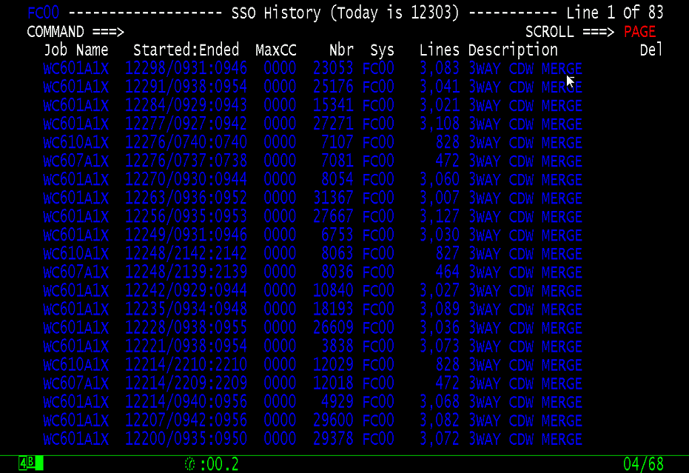
WC6 Series Jobs
WC601A1C runs WA60111a which removes duplicate CLLIs. This is run as COBOL program instead of simple SYNCSORT merge because of border situation cases. Where CLLI exists in 2 bordering states
National Local – is everything not owned by SBC. In other words anything from DC1A

Slide 27
WC415 series of jobs
WC415* jobs extract PVI and LOC data, transforms it and loads for consumption by EDW

Slide 28
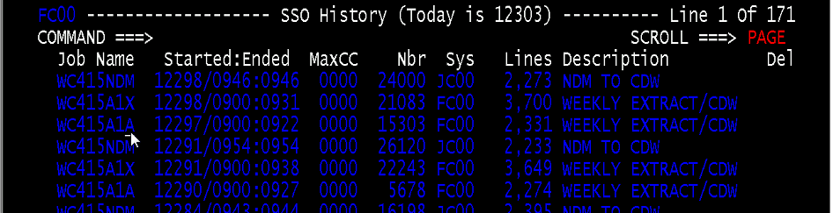
WC415 notes
WC415 jobs pushes data to EDW (used to be CDW or centralized DW)
WC415 aggregates input from PVI, LOC and CLDS and creates a CLLI code record with switch information from PVI. DFG and PVI collection of data is mashed together.
A CLLI code by itself cannot be identified as a Telephone Switch. We can check that it is by looking at PVI tables. “A telephone switch is not a telephone switch if it does not have valid CLLI code from CLDS and valid switch from PVI”
Example devices in the Telephone Network that are not telephone switches are manholes. These are network elements but they are not telephone switches. See SWITCH and NSWITCH

Slide 29
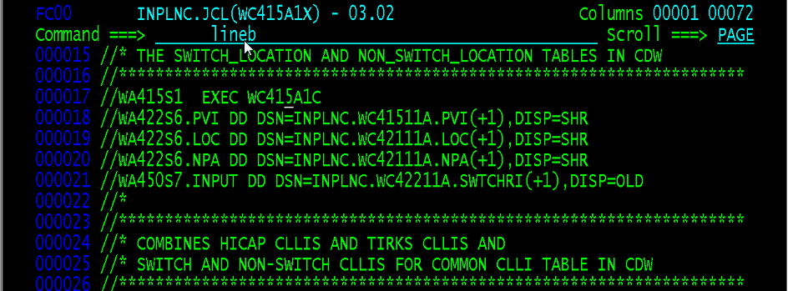
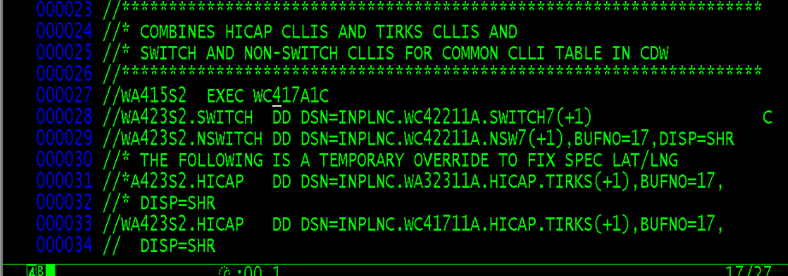
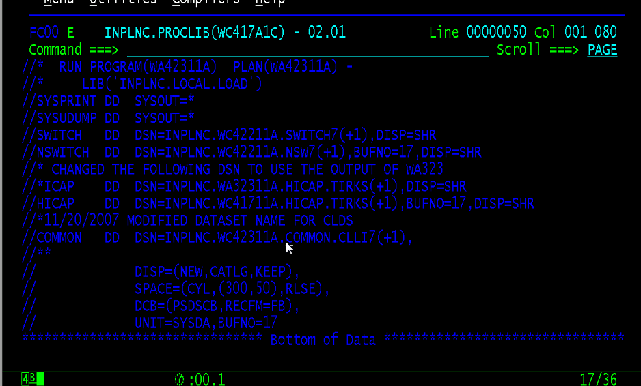
WC415 Job Flow
See INPLNC.JCL(WC415A1X)
WC415 aggregates input from PVI, LOC and CLDS and creates a CLLI code record with switch information from PVI
WC415A1C calls a simple file matching program that matches on sorted keys
A collection is created for switches with associated data and non-switches with associated data
After switch and non-switch file is created, a third file is produced which is a combination of Switch, Non-Switch files. This reformats the combination file.
NOTE: WC415 produces 3 essential files.

Slide 30
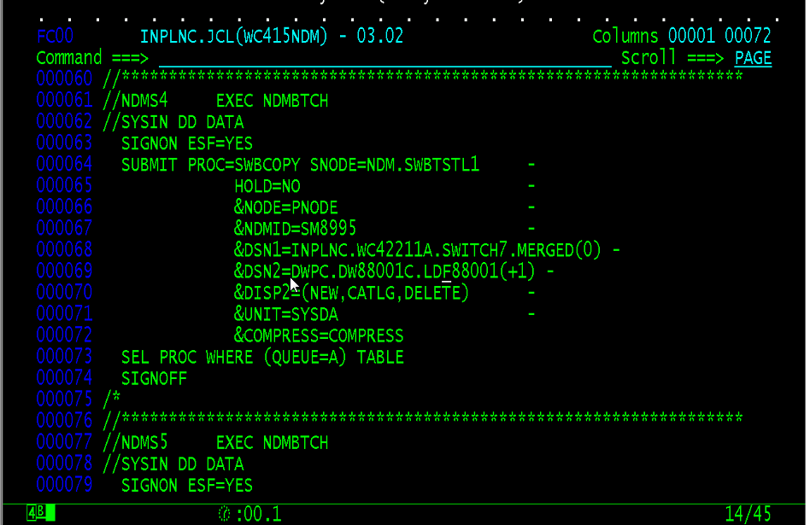
WC415NDM
WC415NDM is the job that finally moves data to the EDW
Embedded in WC415 job is the name of EDW table that is being loaded.

Slide 31
ON-Demand batch processes
These are 2 on-demand processes that require the use of NDM batch jobs:
HI-CAP FORECAST
CLLI_ATTR table updates (CLLI record corrections on production DB2 tables)

Slide 32
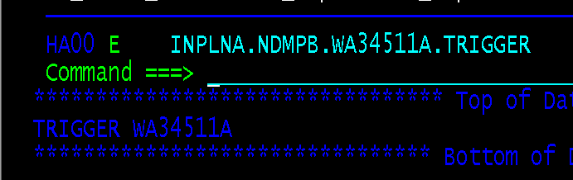
HI-CAP processing summary
INPLNC / INPLNAP
INPLANC.NDMPB.WA34511A.TRIGGER
WA34511A job executes
INPLNA
FC00
INPLANAP.NDMPB.WA34511A.TRIGGER
WA34511A job executes
HC00
INPLANA.NDMPB.WA34511A.TRIGGER
WANDM345 job
INPLNUU
EC00
INPLANUU.NDMPB.WA34511A.TRIGGER
WA34511A job executes

Slide 33
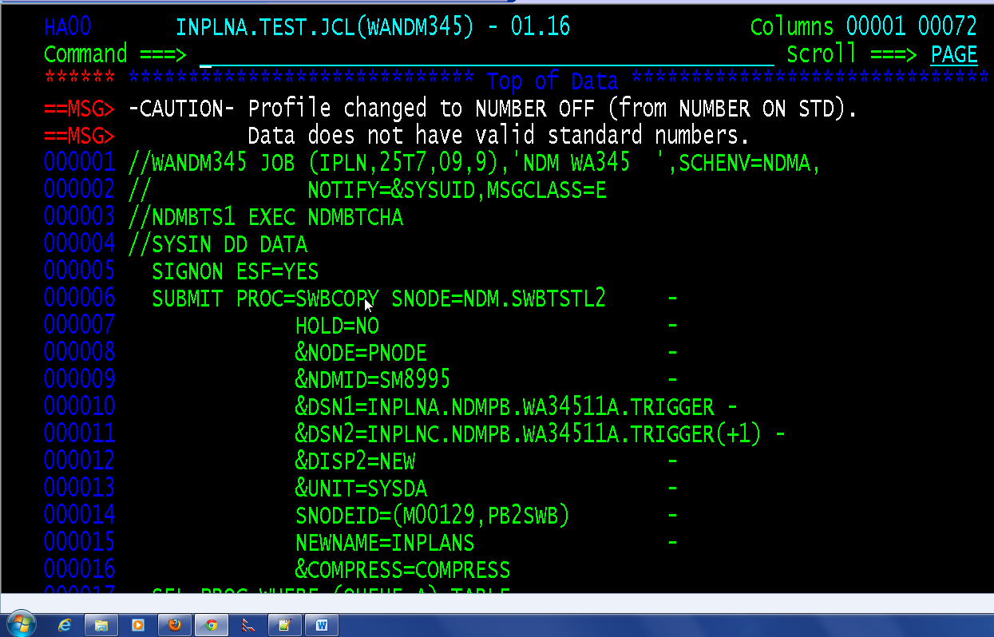
Scenario: Users request HI-CAP batch process to run
Email is sent to INPLANS coordinator requesting to run HI-CAP forecast
Browse INPLNA.TEST.JCL(WANDM345) and Submit
Validate job submission and successful execution
Check that WA34511A job is triggered. Check for job submission and successful execution
NOTE: WANDM345 simply copies a trigger file from the Test System onto the Production System where job WA34511A needs to be run

Slide 34
CLLI batch error correction processing summary
INPLNA test region
FTP
WC314 job
8state file
INPLNa.TEST.UPDATE.8STATE
INPLNa.CLLIATTR.UPDATE.8STATE
WANDM job
ait file
HC00
INPLNa.TEST.UPDATE.AIT
WC314 job
INPLNa.CLLIATTR.UPDATE.AIT
WANDM job
mow file
INPLNa.TEST.UPDATE.MOW
WC314 job
INPLNUU.CLLIATTR.UPDATE.MOW
WANDM job
INPLNUU
INPLNC / INPLNAP
Presence of CLLIATTR update
File triggers a Auto-scheduled job to update CLLI table for region
Presence of CLLIATTR update
File triggers a Auto-scheduled job to update CLLI table for region
EC00
INPLNUU.CLLIATTR.UPDATE.FILE(+1)
FC00
INPLNC.CLLIATTR.UPDATE.FILE(+1)
INPLNAP.CLLIATTR.UPDATE.FILE(+1)

Slide 35
Scenario: Users request to run corrections on current values of CLLI table. Nancy Newman’s group have their own Geo tool to determine lat/long values for CLLI codes. They use the tool to create update files. Those are sent to CCI via email to process.
Email received by CCI INPLANS coordinator with file attachments . The attachment is a sequential file/s. It contains records of CLLI codes with updated/corrected field values
Download emailed files in local or network drive for record keeping
In Mainframe Test Region HA00, allocate a new PDS with appropriate record length (170 in this case). This is based on processing requirements
In PC, Launch Attachmate Reflection… FTP Client… Choose the region where you wish to copy your file
Enter bolded command in ftp> command line of FTP Client window put yourfilename ‘inplna.sample.file’
Validate that file is FTP’d to the Mainframe Test System
Prepare JCL. Change SORTIN in JCL job WC314 to point to uploaded file
Submit job and validate successful execution
NOTE: Repeat process for every file attachment. Each file updates a specific Mainframe Production Region
Prepare NDM JCL for this process. The NDM jobs move the output file generated from the Test System to their respective Production Systems
Update WANDM314 with the input file to be processed. Validate that the nodes, high level qualifiers correspond to the correct target Production System
Submit job and validate successful completion
CCI’s job is done when the CLLI update files are successfully uploaded to the correct Production Systems
NOTE:
a. Repeat NDM batch process for every test system update file that needs to be sent to the Production Systems.
b. The files uploaded are ‘trigger’ files. They trigger submission of predefined jobs by the Auto Scheduler when their presence is detected.

Slide 36
Obsolete Pieces of INPLANS
Mergers and Application Rationalization has caused pieces of INPLANS to be retired and replaced
Example of retired applications are ITE and LOC
CLDS replaced LOC. CLDS simplified the complexity in LOC.
INPLANS used to have on-line IMS functions but is now all removed

Slide 37
RACF (Resource Allocation Control Facility)
RACF is IBM security software
RACF access controls a user’s ability and rights to access a mainframe system
CCI RACF access example:
SYSTEM | RACF access to PDS
EC00 | Read Only
FC00 | Read Only
HA00 | Create, Read, Update, Delete
AA00 | Create, Read, Update, Delete

Slide 38
ESP Automatic scheduler
ESP instructs mainframe to run jobs. It has triggers that make jobs run automatically

Slide 39
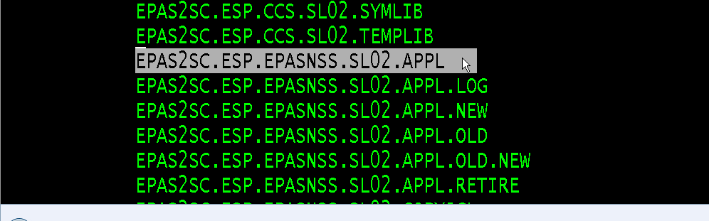
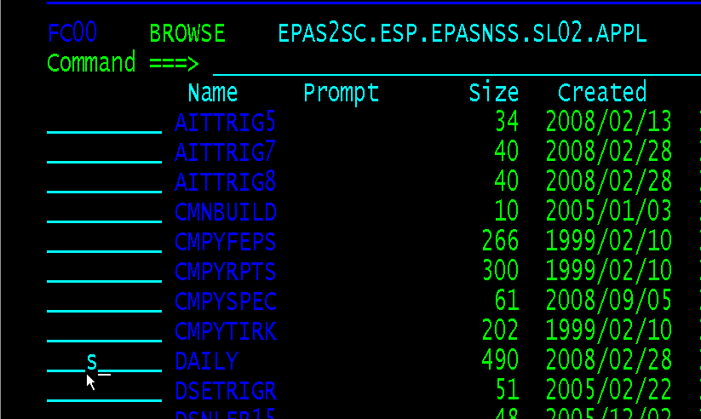
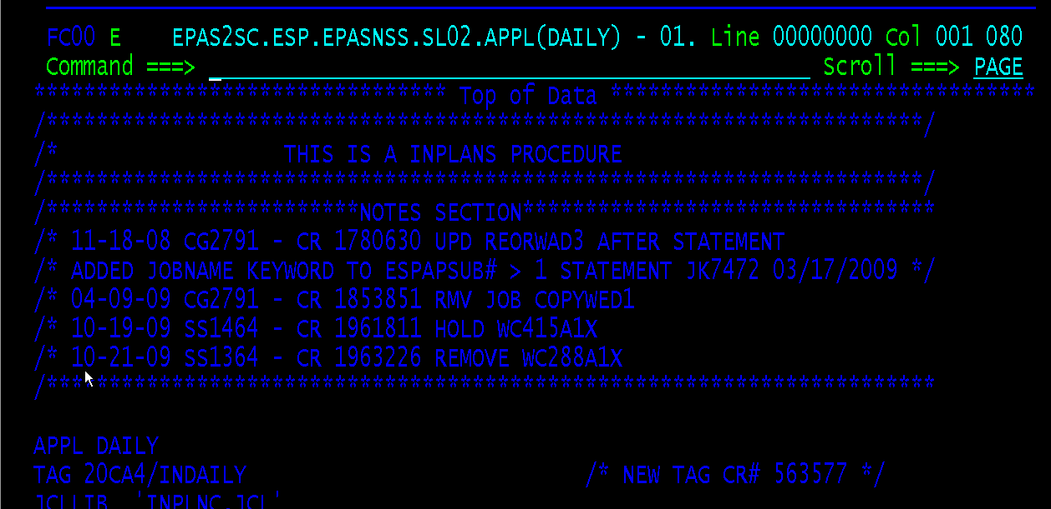
ESP Notes
ESP is not maintained by CCI. ESP is supported by EPAS
CCI does not directly use it.
See ‘EPAS2SC.ESP.EPASNSS.SL02.APPL’
The dataset contains a listing of jobs.
The jobs define the frequency, sequence and schedule of runs.

Slide 40
Viewing data sourced from inplans in edw website
EDW is the final repository of INPLANS data. The website is a good resource for researching INPLANS data tables

Slide 41
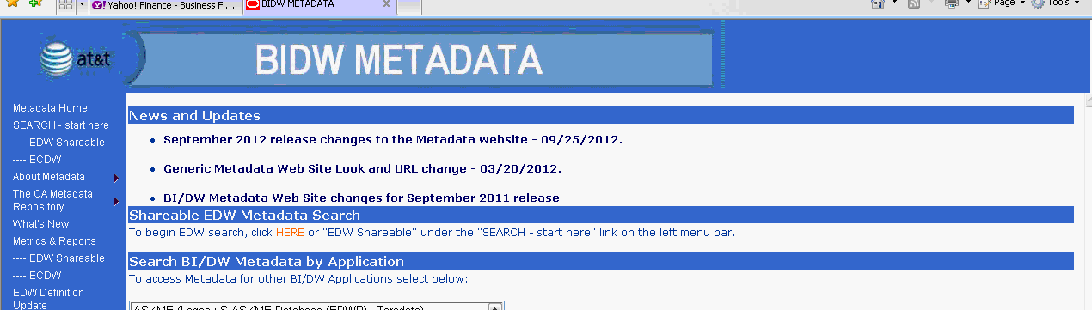
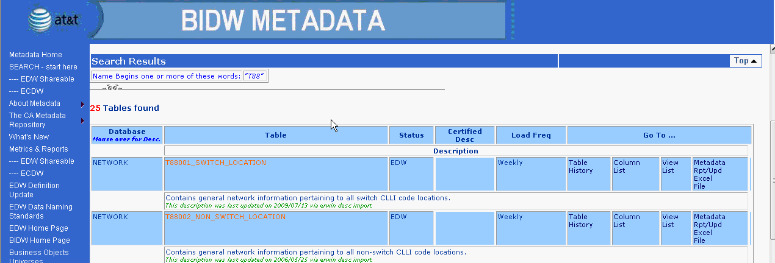
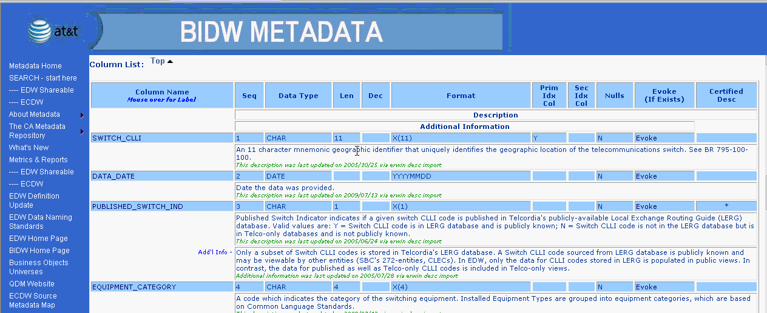
http://edw.sbc.com/metadata/index.htm
Click Shareable EDW Metadata Search and enter ‘T88’ in search field
See T88001_SWITCH_LOCATION. Table is from weekly INPLANS load job
Clicking on table will show more detailed links including a link to view table columns

Slide 42
List of INPLANS -> EDW tables
Note: Files to look for are INPLNC.WC* no WA*
EDW Table # | INPLANS dataset name sent to EDW
T84005 | INPLNC.WA41011A.MKTAREA(0)
T84007 | INPLNC.WA41011A.LATA(0)
T84008 | INPLNC.WA41211A.OCN(0)
T84014 | INPLNC.WA41011A.DPLYAREA(0)
T84041 | INPLNC.WA41011A.MKTREGN(0)
T87070 | INPLNC.WA23311A.SERVICE(0)
T87071 | INPLNC.WA23311A.FCST(0)
T88001 | INPLNC.WA42211A.SWITCH7.MERGED(0)
T88002 | INPLNC.WA42211A.NSW7.MERGED(0)
T88003 | INPLNC.WA60711A.NPANXX.MERGED(0)
T88007 | INPLNC.WA42311A.COMMON.MERGED(0)
T88121 | INPLNC.WA43611A.T88121(0)
T88122 | INPLNC.WA44711A.T88122(0)
T88130 | INPLNC.WA43911A.T88130(0)
T88131 | INPLNC.WA44011A.T88131(0)
T88132 | INPLNC.WA44011A.T88132(0)
T88151 | INPLNC.WA24111A.ACTUALS(0)
T88152 | INPLNC.WA24111A.FCST(0)
T88161 | INPLNC.WA44711A.T88161(0)
T88162 | INPLNC.WA44711A.T88162(0)
T88163 | INPLNC.WA44711A.T88163(0)
T88164 | INPLNC.WA44811A.SWCAP.T88164(0)
TCCN004 | INPLNC.WA41011A.EQPTTYPE(0)
TCTN101 | INPLNC.WA40711A.SWPRFCST.SWRI(0)
TCTN106 | INPLNC.WA40611A.WRKGQTY.SWRI(0)
TCTN107 | INPLNC.WA40611A.WRKGPROD.SWRI(0)
TCTN108 | INPLNC.WA40111A.TRKGRP(0)
TCTN109 | INPLNC.WA40011A.TRKGRPF.RI(0)
TCTN110 | INPLNC.WA40111A.TRKGRPU(0)
TCTN111 | INPLNC.WA40311A.SWCPCTY.MERGED(0)
TCTN112 | INPLNC.WA40311A.SWFUNC.MERGED(0)
TCTN120 | INPLNC.WA40311A.SWEVENT.MERGED(0)

Slide 43
Using qmf for windows
QMF is a tool used to perform SQL functions (CRUD actions) on DB2 tables. Mainly used to run personal SQL queries on the tables.

Slide 44
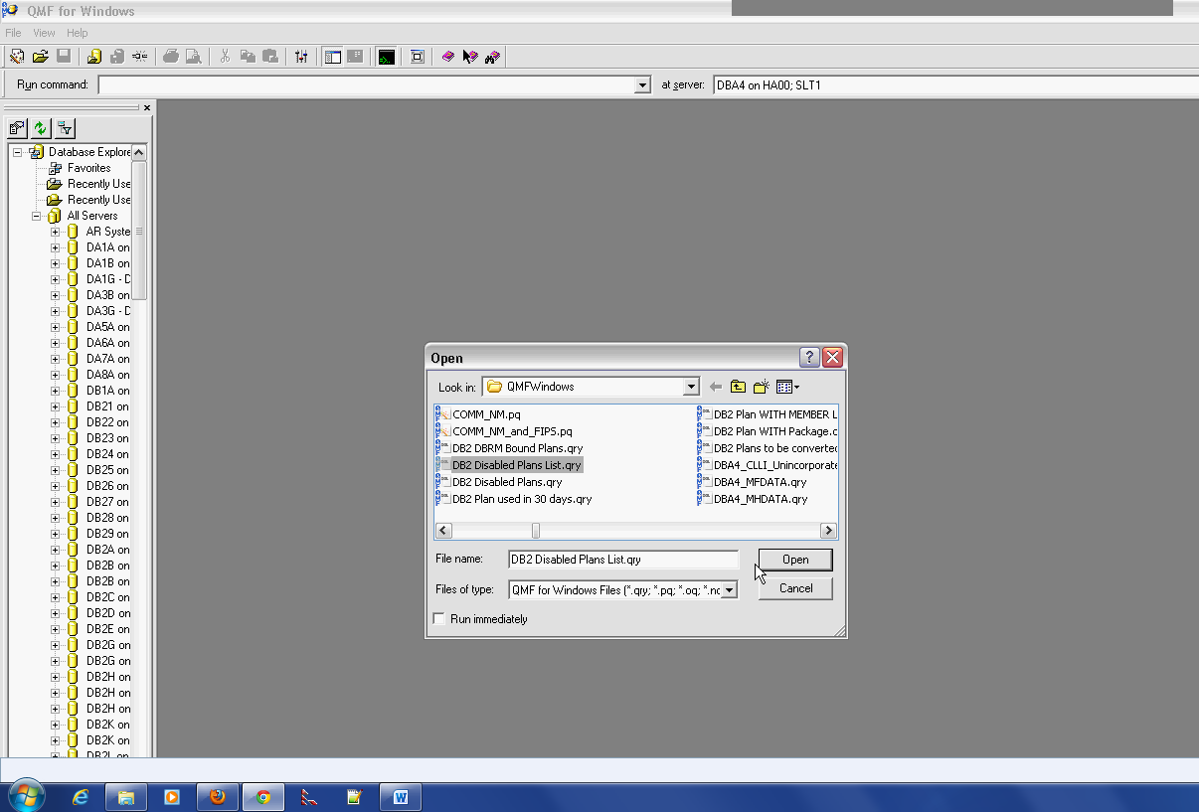
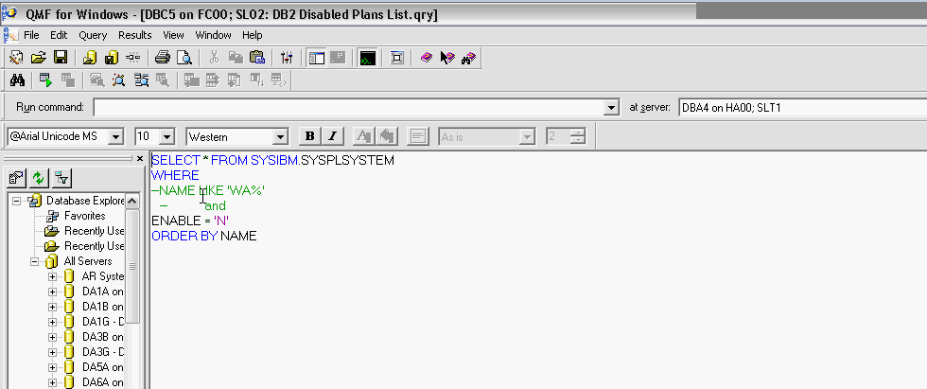
QMF for Windows
Download and install QMF for Windows from the Software Store
Launch QMF for Windows from Windows Program list
Type in SQL query and run SQL to retrieve rows from database

Slide 45
Delivering software to production
CHANGEMAN, AOTS and CMNTOOLS

Slide 46
5 Stage Process for Production Software Delivery
AOTS: Request and Approval
Package Component (SRC)
CHANGEMAN: Create Changeman Package
Package Component (JCL)
INPLANS Component installed in Production SL01 and/or SL02
Package Component (x…)
CMNTOOLS: Tie Changeman Request and AOTS request together
CHGMAN: Audit, Freeze and Approval

Slide 47
Production Delivery Details
Step 1: Create a CHANGEMAN Package
Include all components (SRC, JCL, PROCLIB, CNTLCARD, etc) needed for the specific change
Complete all testing
Complete all software approvals
Step 2: Create an AOTS ticket/request to install the software changes to the appropriate production system
Complete information requested in all tabs
Submit Request for approval
Step3: Launch CMNTOOLS in Test System
Tie together the Changeman package number and the AOTS ticket number
Step4: Launch CHANGEMAN for last steps
Perform Audit, Freeze and Approve steps
Step5: Validate installation of new software in production
Additional Admin Steps:
Step 5a: Close AOTS ticket
Step 5b: Update ‘SCM Verification Spreadsheet – INPLANS yyyy’ to track all changes introduced to INPLANS production systems

Slide 48
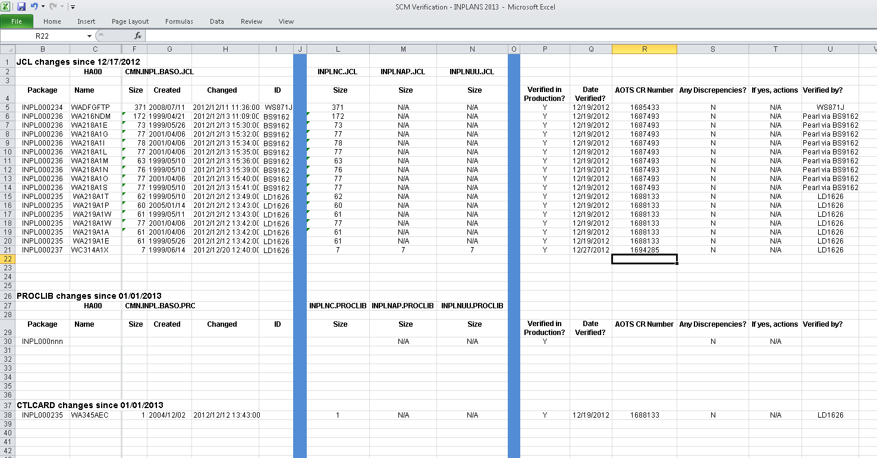
Sample SCM Verification XLS

Slide 49
Inplans Enhancements vs maintenance
AT&T and CCI contract details on terms of service

Slide 50
Support and Maintenance
Maintenance = repairing software problems. If changes are needed because environment changing… that is maintenance.
Support = something not running properly in production such as failed jobs and erroneous output from INPLANS jobs. Support also includes “small scale” revisions to code.
Keeping the current system running under new technology with no new functionality or features introduced

Slide 51
Enhancements
Enhancements = are not part of contract. Making software do things that it hasn’t done before. Large scale revisions are not covered by contract.
Enhancements work like this: Sheronda Martin/Adrianna contacted by client organization requesting INPLANS to do something different. New programs to run, etc.
Next step in enhancement is contacting Chris. CCI/Chris will estimate scope, possible changes, document and present to AT&T. This is done by submitting SOW (Statement of Work document)

Slide 52
Players
Adrianna Krevitz: AT&T person in charge of INPLANS
Sheronda Martin: AT&T technical manager for INPLANS.
Nancy Newman: Client on Network Engineering. Handles nationwide CLLI codes for EGIS.
Carol Spivey: Client on Network Planning, DFG
EPAS : Team responsible for handling mainframe operations (Contact Number: 248-424-4222)
Use Web Phone for specific employee information and group structure : http://webphone.att.com/

Slide 53
Resources and Support Information
CHANGEMAN:
CHANGEMAN_MVS email support
Terri Menchak (ts9021)
DB2 issues including QMF for windows:
DB2 Help Service Machine DB2HELP/St Louis/IBMdb2help@us.ibm.com
Mainframe System Issues (EPAS production problems, JCL, INPLANS, RACF, Admin)
Sheronda Martin

Slide 54
Telcordia
ccompell@telcordia.com / christopher.compell@ericsson.com
help-bae@mk.telcordia.com
AOTS (Remedy)

Slide 55
Helpful Links
MOTS:
http://ebiz.sbc.com/mots/index.cfm(Application documentation for all AT&T apps)
EDW Metadata:
http://edw.sbc.com/metadata/index.htm(Documentation of all EDW tables)
QMF Windows:
http://mvsha00.sbc.com/appl/db2/web.site/qmfwin.html

Slide 56
Shared Drive:
\\ntstlfs02\inplanspics
Attachmate Extra:
http://softwarestore.it.att.com/

